Slide 1
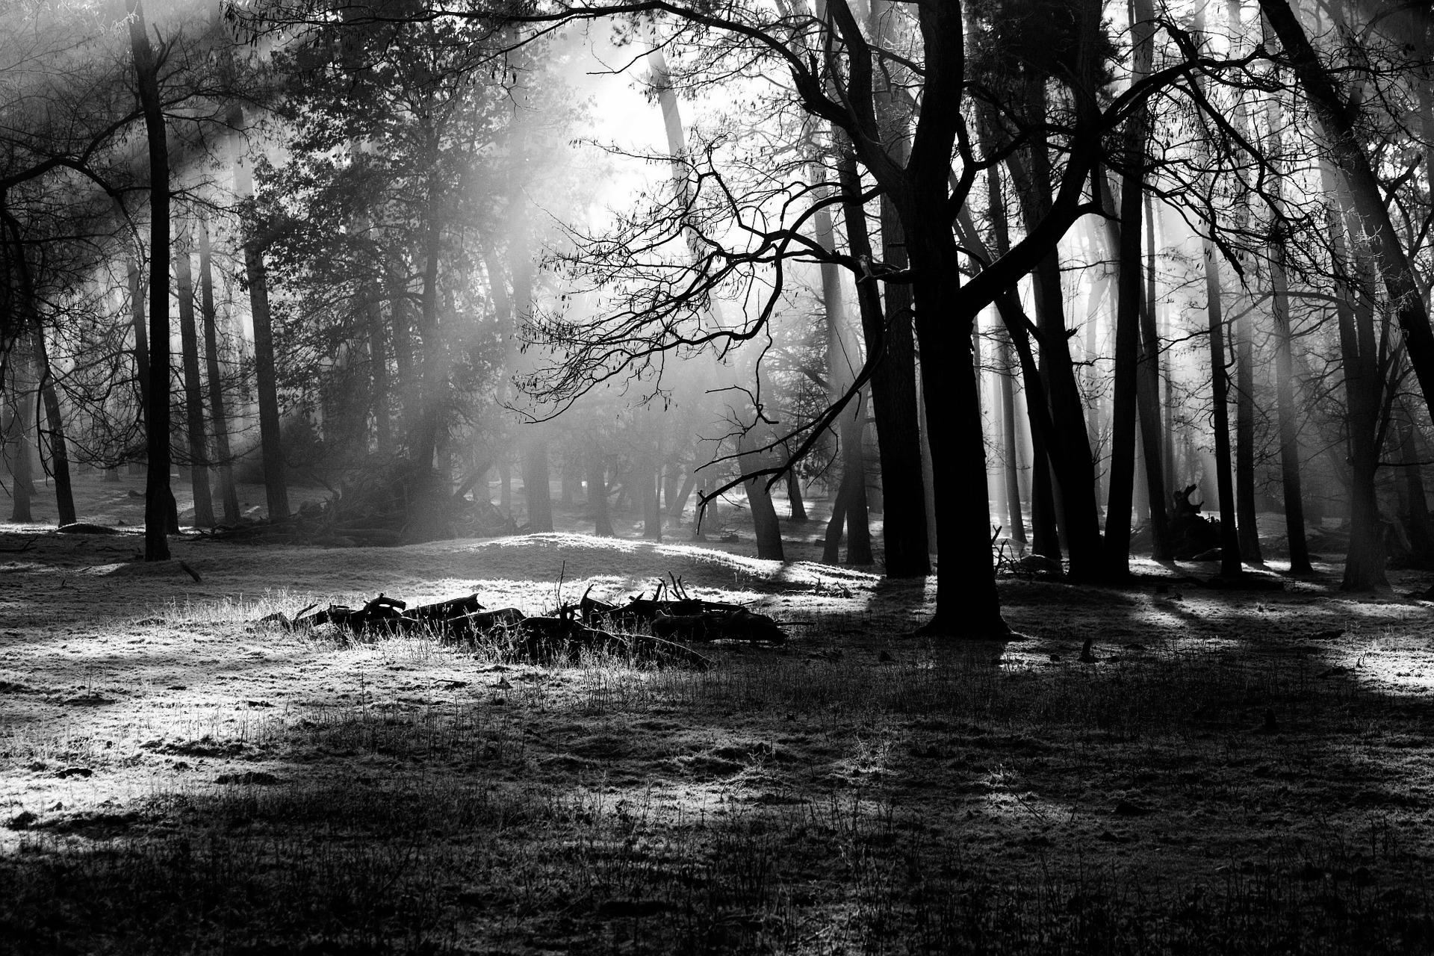

BATALOG
Progress
Report
#2.3
I
Group Members:
Hadi S. ( h_soufi) | David M. (dlmassey)
Rahim I. (r_iqbal) | Kevin K. (knkeomal)
Thien L. (t_le)

Slide 2
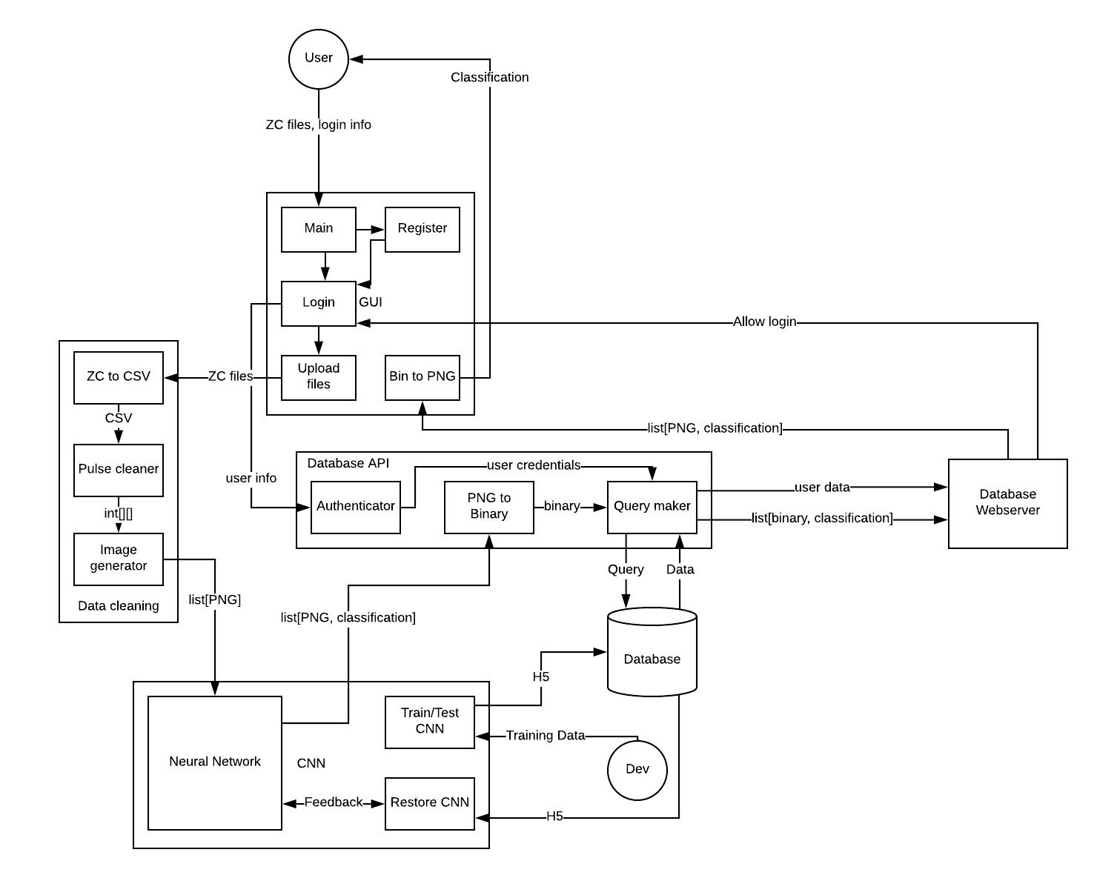
Overall System Model

Slide 3
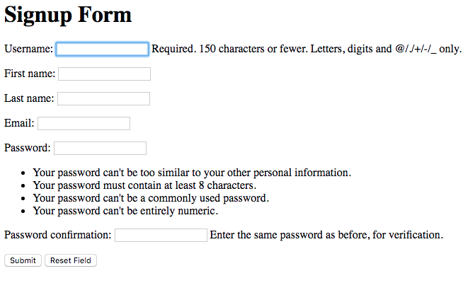
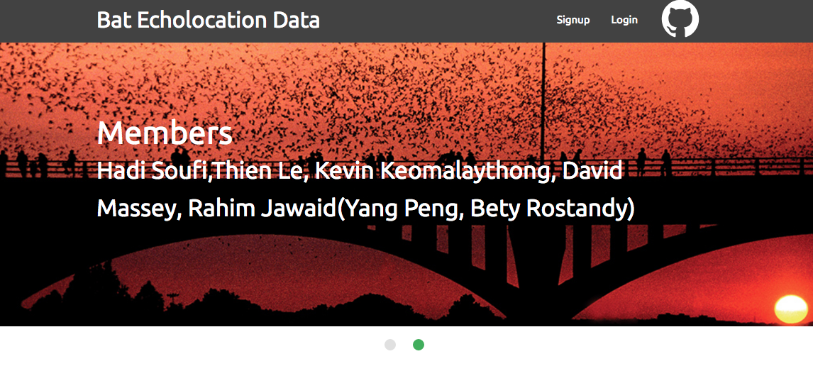
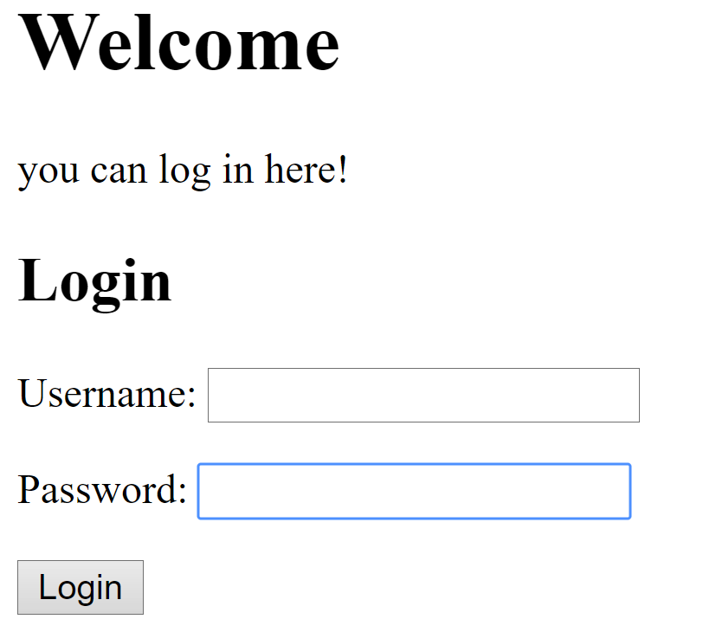
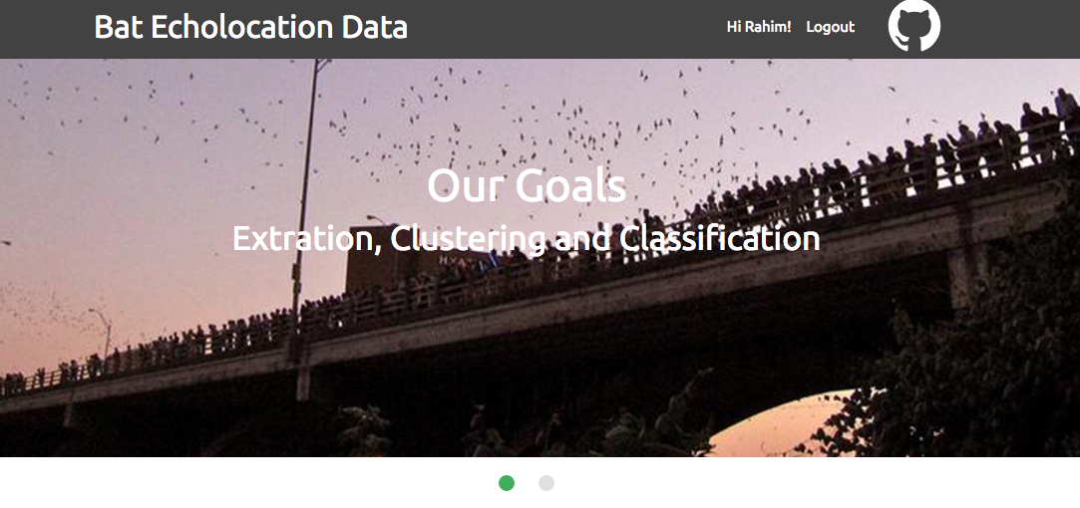
SignUp, Login, and Logout

Slide 4

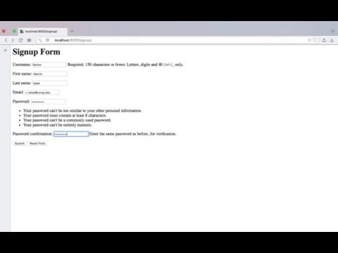
User signup, and login demo and user validation

Slide 5

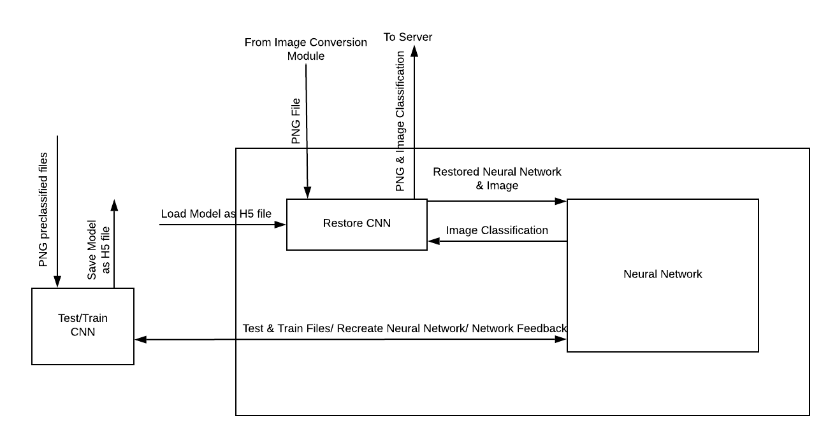
CNN
Created Restore CNN function to work with a single image and array of images
Recreated Test/Train CNN to work with an array of images & caused OOM error
Continued to test CNN models to increase accuracy
I

Slide 6
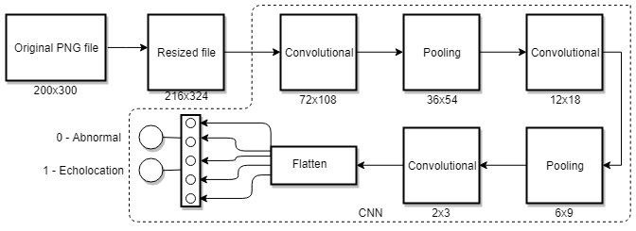
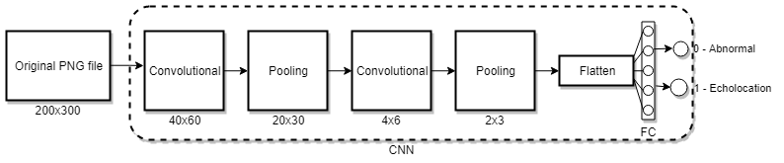
CNN
I

Slide 7
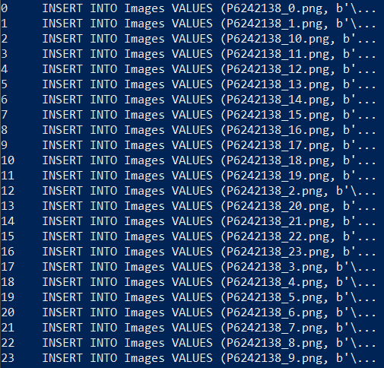
Database API Progress
Command-line testing
DB API output →
Handling PNG images
Later on: creating and modifying DB tables; handling user reg info
Django’s intrinsic DB API
models.py → tables
Python shell w/in cmd
Possible incorporate my API?

Slide 8
Live server
Personal server
Inexpensive
Flexible
High maintenance
UNCG Virtual Server
Reliable
Payment plans
Project appropriate
Web-Hosting Company
Get what you pay for
Research important
Powerful features
Requirements
24/7 live access
>10GB of storage
Low end specs

Slide 9
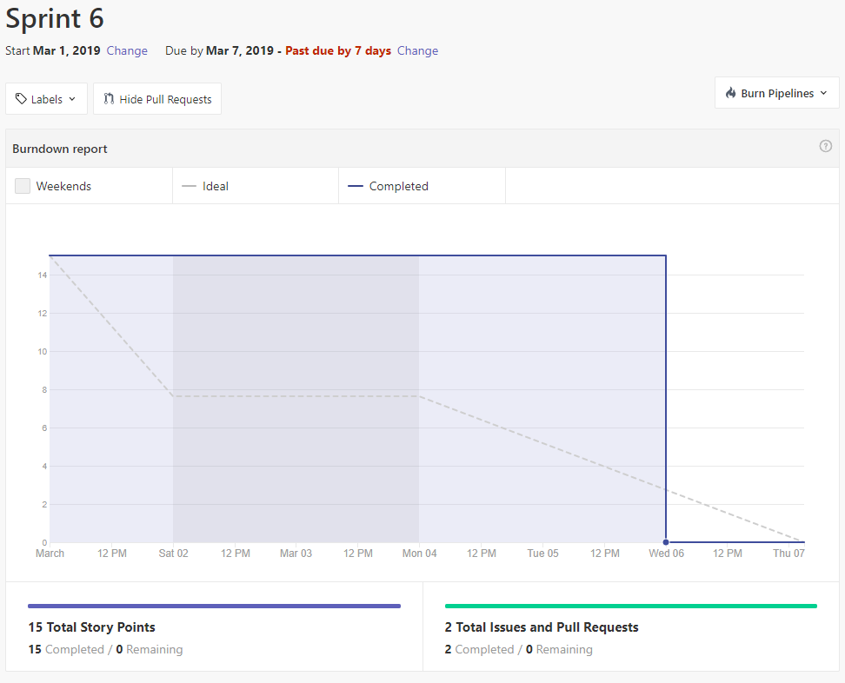
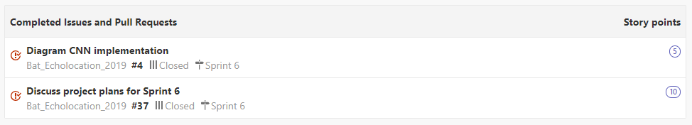
Scrum Sprint 6

Slide 10
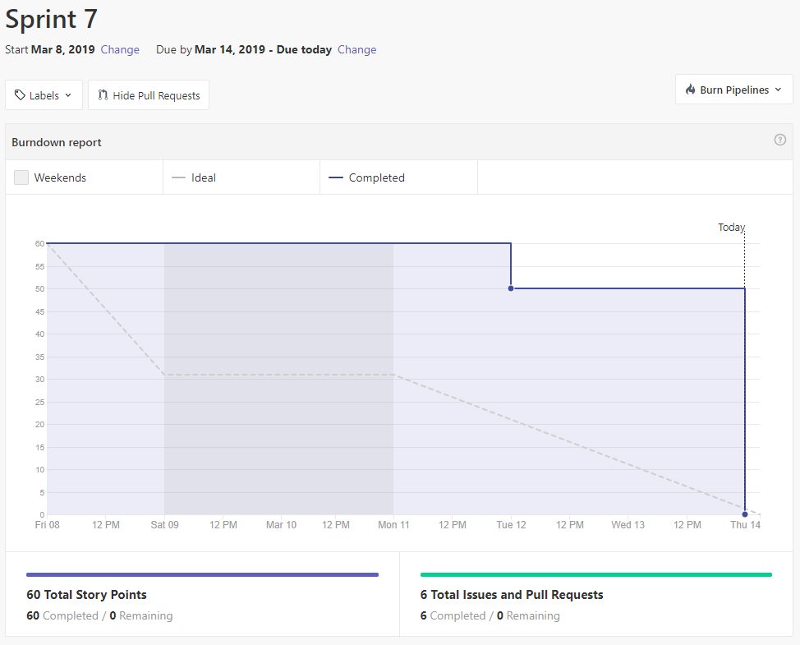
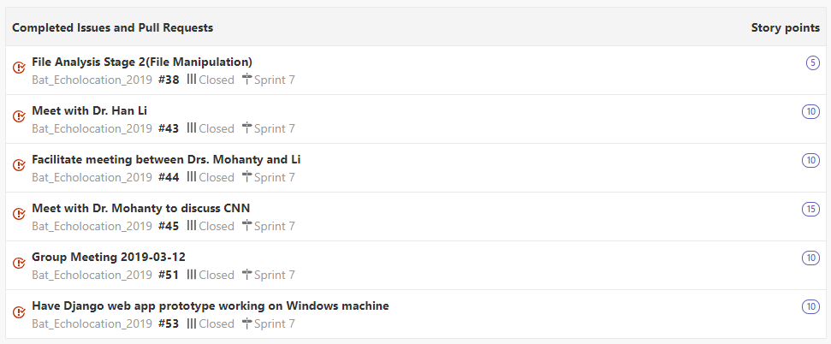
Scrum Sprint 7

Slide 11
Thank you!
BATALOG
Progress
Report
#2.3
I
Group Members:
Hadi S. ( h_soufi) | David M. (dlmassey)
Rahim I. (r_iqbal) | Kevin K. (knkeomal)
Thien L. (t_le)

